Slide 1
Computational Thinking
MINI PROJECT

Slide 2
DOMAIN
Small Scale Organization

Slide 3
Problem Statement
An ABC Company wants to conduct an election for choosing the employee club president. The company wants to conduct the election in a simple, cost-effective and secured way through online mode. Design a program for implementing Online voting system satisfying their requirements.

Slide 4
Objective
To design an algorithm , flowchart and program for secured online voting system by using data encryption and analyze its running time efficiency.

Slide 5
Algorithm:
1. start the program. 2. get the voter name. 3.check whether the voter name present in the voters list print your name has been verified. otherwise print not verified. 4.Read an input , ch. 5.Check whether the ch=1 print voters list and symbols. 6.Check whether the ch=2 Get the vote from the voter. check whether the symbol entered matched with the symbol in voters
list. print successfully voted. otherwise print try again. the choice list is displayed again. otherwise print invalid choice. 7.End the program.

Slide 6
ENCODE:
1.start the program. 2.get the symbol. 3.declare i=0 and set the condition arr[i]!='\0'. 4.check whether i%2==0 increment arr[i]+=4 increment i value. otherwise decrement arr[i]-=4. increment i value. 5.Repeat step 4 till the condition is true. 6.save the result in file. 7.End the program.

Slide 7
DECODE:
1.start the program. 2.get the symbol. 3.declare i=0 and set the condition arr[i]!='\0'. 4.check whether i%2==0 decrement arr[i]-=4 increment i value. otherwise increment arr[i]+=4. increment i value. 5.Repeat step 4 till the condition is true. 6.save the result in file. 7.End the program

Slide 8
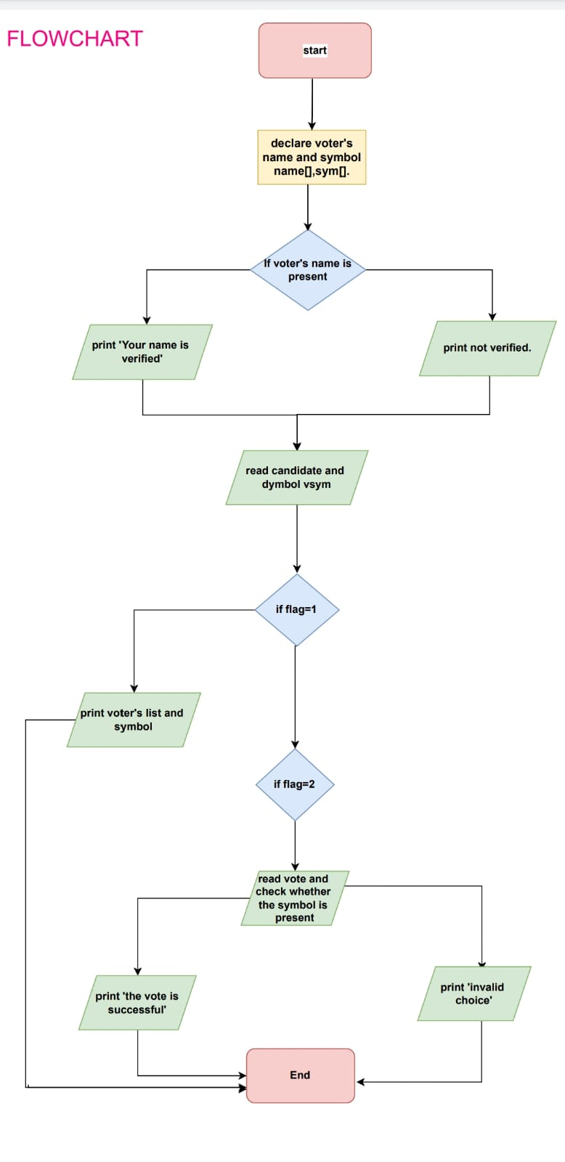

Slide 9
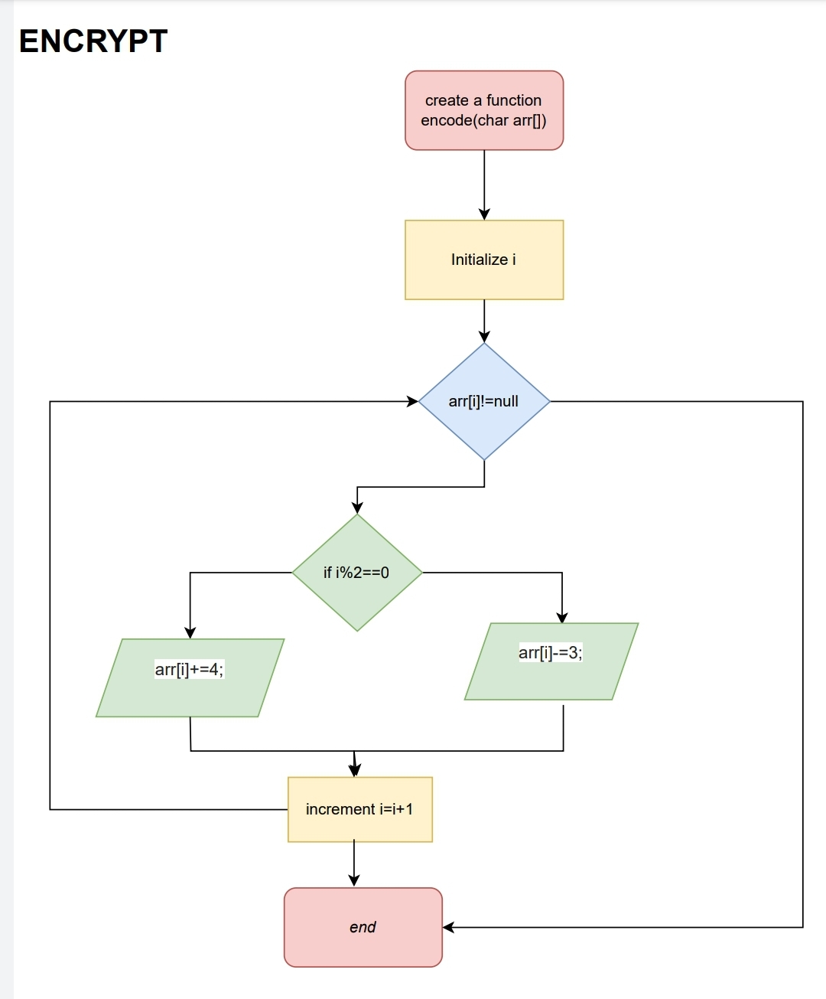

Slide 10
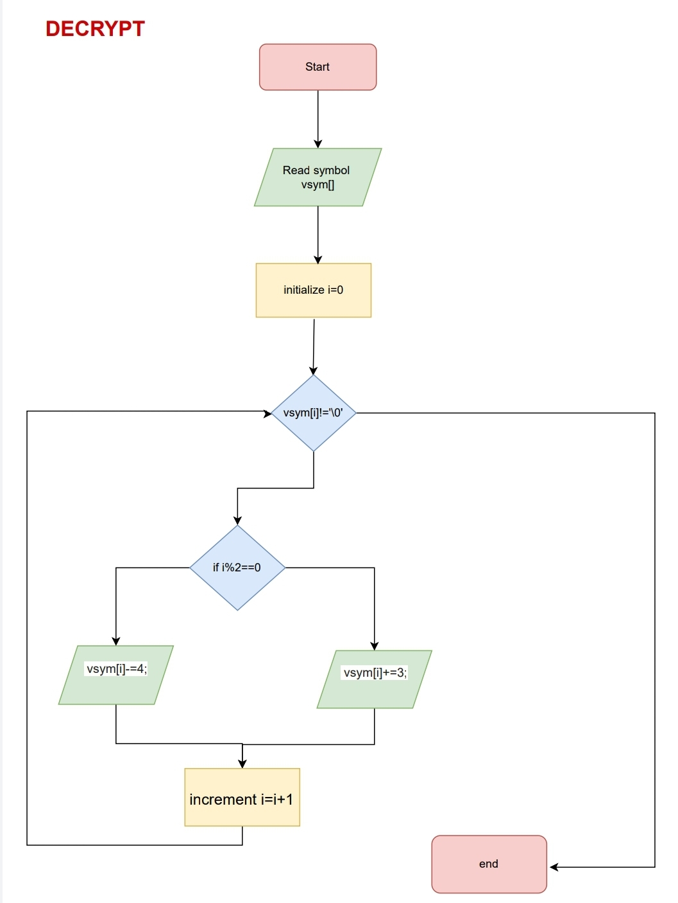

Slide 11
PROGRAM
Click here to view the program 1
Click here to view program 2

Slide 12
Running Time VS Array Size

Slide 13


